Slide 1

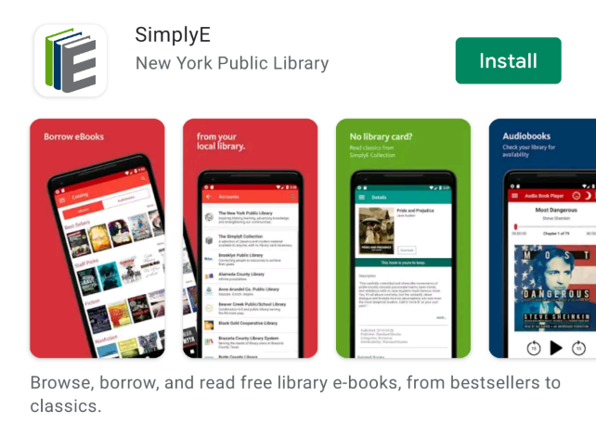
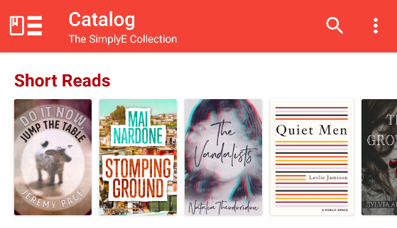
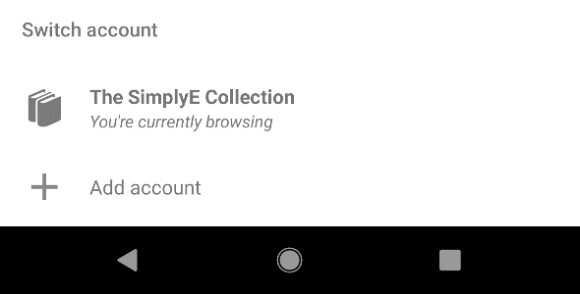
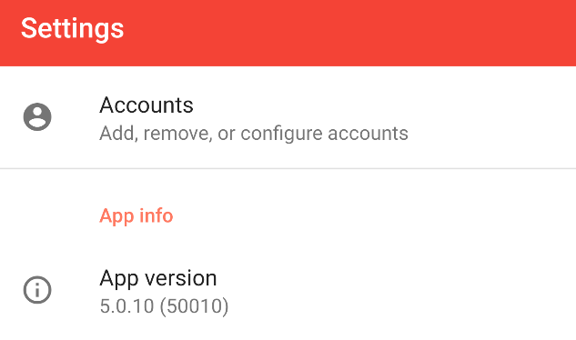
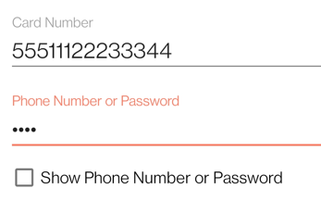
Newton County Public Library
Ebooks From Your Library To You
SimplyE for Android Devices
What is SimplyE?
SimplyE is a free app that allows you to search Newton County Public Library’s ebook and audiobook collections across multiple sources, all at the same time, and download them to your Android tablet or phone.
You will need an Android device (v 5.0 or higher), and a valid library card number and password.
SimplyE is not compatible with Kindle or Nook devices.
Getting Started
Install the App
Open the Google Play Store app and search for SimplyE
Tap Install, then open the SimplyE App
Tap Agree to accept the Terms of Service
Log In to your Library
If it’s your first time using SimplyE, tap Find Your Library; otherwise tap the ≡ icon on the upper-left corner, then Add account
Locate and tap Newton County Public Library in the list
Tap Accounts, then Newton County Public Library.
Enter your library card number and password
Tap Log in
Select Your Library’s Catalog
Tap Catalog in bottom left corner
Tap icon in upper left corner; select Newton County Public Library
The library’s catalog will appear

